Slide 1

Migrating to Java 11
A Java Talk

Slide 2
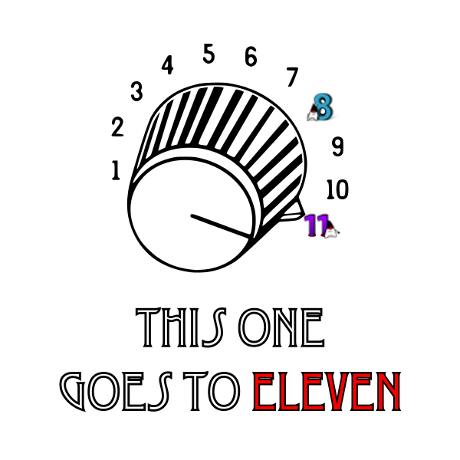
Callouts
A few quick mentions of some of the groups involved in motivating this tech talk
Architecture Guild (yo/architecture-guild)
Technical Excellence Developer Productivity Working Group (yo/eng-handbook)
Java Interest Group (yo/java + yo/java-interest-group)
Notes:
Short notes:
Proof that it’s possible to catalyze positive change in the company
Up to us - up to “all of us” to look for opportunities where we can find and join or form groups to help strengthen our developer community.
Some ways these groups have shown positive influence:
Informing
Motivating
Inspiring
Helping or supporting
--- now on to the Tech Talk 😀
Long version
Sheridan:
I’m so excited to be a part of this. Not just for the talk we’ll be giving, but because we were inspired and motivated to form this java interest group.
What’s thrilling to me is that the groups, which I’m calling out here - Architecture Guild, and Developer Productivity working group have shown to me and others here an example of making positive change for the organization.
These groups have highlighted that not only is positive change possible, but is up to us. It is up to all of us to find and join communities and to help drive positive change ourselves and to both pay it back and pay it forward.
This newly formed Java Interest Group hopes to do this by doing the same things that got us excited about forming the group itself:
Informing
Motivating
Inspiring
Helping / supporting
So big thanks / callouts to these groups and announcing our Java Interest Group
--- now on to the Tech Talk 😀

Slide 3


PSA: Migration to AdoptOpenJDK - What do I do?!?
I own a screwdriver or base image that includes java
Add more choices of your platform or base image
openjdk8 - AdoptOpenJDK 8
openjdk11 - AdoptOpenJDK 11
openjdk (optionally - latest AdoptOpenJDK - 16 e.g.)
I use a screwdriver or base image that includes Java
⇐ Switch to adopt image variant provided by owners
🔥If there are no variants or owners, start lighting fires to get one made!

Slide 4
JDK Roadmap
AdoptOpenJDK 17 Release
AdoptOpenJDK 8 EOL
May 2021
Oct 2024
Sep 2021
May 2026
Oracle JDK 8 EOL
End of support contract
AdoptOpenJDK 11 EOL
https://adoptopenjdk.net/support.html
Notes:
Ask from internal STC meeting regarding "yjava" and its supporting packages. What is the future on premise and aws for Java? Are yjava packages going to be revved for RHEL 7, etc. Do we recommend yjetty or should everyone just use undertow, etc. Are there RPM's for yjava?

Slide 5
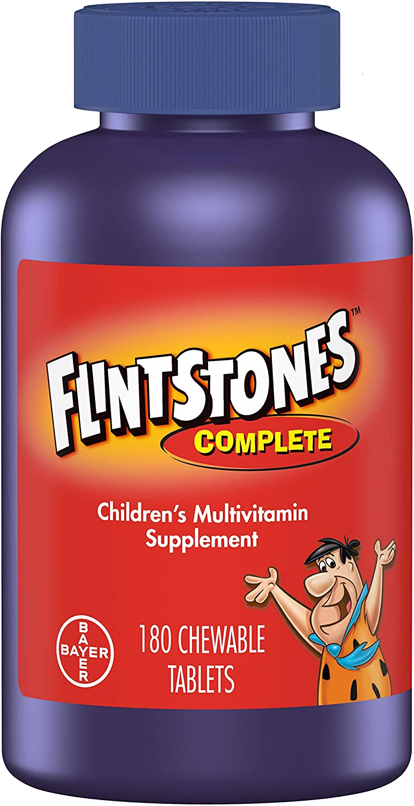
Why moving to Java 11 is good for you
Non-comprehensive list of reasons why upgrading is good:
Language improvements
Standard library improvements
Performance improvements
Standardized module system
Preparing for Java 17
Java 8 will not last forever

Slide 6
Why upgrade: Language improvements
Improved type inference (“var type”, empty diamond in more places)
var data = new HashMap<String, Integer>();
Allow effectively-final variables in try-with-resources
try (is) { /* Do stuff with is */ }
Private methods in interfaces (for code reuse in default methods)

Slide 7
Why upgrade: Standard library improvements
Convenience factory methods for immutable collections
Very similar to Guava: List.of() Set.of() Map.of()
Standard pub-sub framework
Semantic equivalent of Reactive Streams in standard library: java.util.concurrent.Flow
Improvements to Optional
Interoperability with Stream
Better mapping constructs when staying Optional or(), map()
Standard HTTP client
Improvements to String
New built-in methods: isBlank(), lines(), strip(), stripLeading(), stripTrailing(), repeat()

Slide 8
Why upgrade: Performance improvements
Overall JIT improvements
Library improvements to commonly used functionality
G1GC improvements for CPU used and latency
Compact strings for memory savings

Slide 9
Why upgrade: Standardized module system
Solving the infamous “JAR hell”:
Dependency A requires X version 4.4.x
Dependency B requires X version 4.5.x
...and those versions are not ABI compatible
Java Platform Module System (aka Project Jigsaw)
Modules explicitly declare what they expose, rest is private in the classloader
Opt-in, by default nothing changes
Will be a while before everyone embraces it

Slide 10
Why upgrade: Preparing for Java 17
Java 17 is the next LTS release after 11, with many exciting new enhancements:
New low-latency garbage collectors: ZGC, Shenandoah
Language improvements: switch expressions, text blocks, record classes, pattern matching instanceof
Improved NullPointerExceptions: java.lang.NullPointerException: Cannot read field "fish" because "foo.bar" is null
String errorMessage = """
This is a very long, multi-line, error message.
Note that the initial indentation is removed, similar to other languages that support text blocks.
""";
String howMany = switch (n) {
case 0 -> "zero";
default -> "some";
};
if (o instanceof String s && s.startsWith("foo")) {
return s.toLowerCase();
}

Slide 11
Why upgrade: Java 8 will not last forever
Java 8 is supported by AdoptOpenJDK until at least 2026...
...but you may be forced to upgrade earlier
Paranoids update requirements for TLS ciphers and other features…
...which aren’t always backported to Java 8...
...you may get S-ticket and be forced to upgrade with short schedule
Open source projects won’t build Java 8 compatible libraries forever
Inner source libraries won’t support Java 8 forever

Slide 12
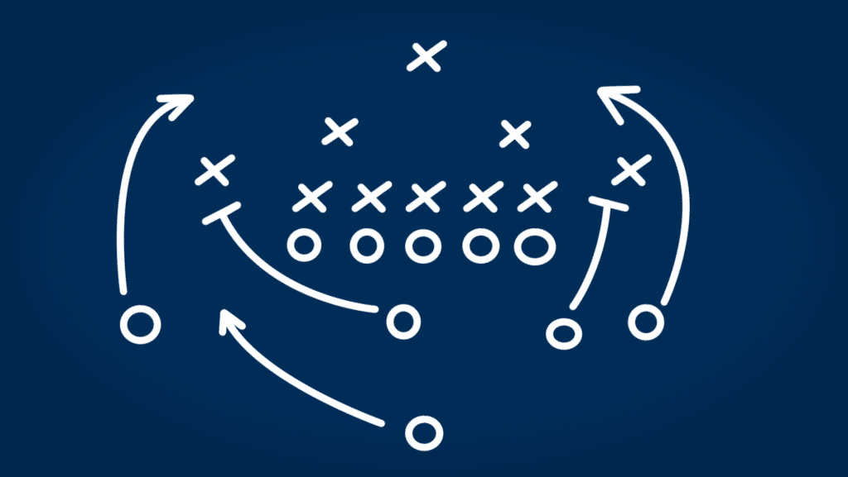
Plan of attack; prioritization
Start with run time upgrade to Java 11
Start by running your code with Java 11 without changing the build process and run that for a few weeks before changing your build pipeline
Running code built for Java 8 on Java 11 is generally safe and will expose corner cases
In this mode you will have one JDK to build and another JDK/JRE for runtime
If you’re not up-to-date, upgrade your dependencies wherever possible (Use compiler to find required upgrades; make them for Java 8 for battle-testing and fewer diffs to 11)
Gradle/Maven + their plugins
Tricky/Reflective stuff like Guice, Jersey, JAXB, other Java EE things
Testing/mocking frameworks
Cross-compile your libraries with Java 11 for Java 8
It is OK, necessary, recommended to add the external deps on Java EE things during this phase
Compile libraries with 11 for 11
This is the end-game; when you feel that everything consuming your libraries can consume 11 classes
Note that ygrid does not yet have a timeline for supporting jdk11; if you have pig/spark/storm, pause here.
If possible remove usage on JNI yjava* classes, to reduce problems on Java 11. Example: yjava_ycore, yjava_yiv, yjava_yca, etc.
Notes:
Compiling with 11 for 8 will require adding deps on JavaEE things, which is ok when running on 8 JVMs.
Compiling with 11 for 11 is only when you know all your deployments can support 11 (i.e. not running on ygrid - Spark/storm)

Slide 13

Things to expect while migrating
Java EE interfaces moved out to external dependencies ⇐ pretty easy to just add
If you’re not up-to-date with latest java libraries, maven/gradle and their plugins you’ll need to do that
FYI Tech Excellence: Update Management - Application & Dependency Update Guidelines
Dependency upgrades may be required to move to Java 11 but are not considered “part of it”
Some “bad practices” may break you
Relying on type-erasure too much (Java 11 adds more type casting checks - see Feb blog post)
Scanning classpath using URIClassLoader not supported ⇐ switch to ClassGraph (more ahead)
Some “ok advanced practices” may break
JNI - the resource cleaner often used to destroy C++ objects has moved
setcap to use low-ports may behave differently (more ahead)
Some Java CLI flags have changed
JEP-158 Unified logging
Garbage collection flags
Container support: -XX:-UseContainerSupport
Notes:
Dependencies not considered “part of it” because they are good practice anyway; if up-to-date with jdk8, this is No-op

Slide 14

Cookie validation
We recommend using Canonical Profile or Member Profile web services to validate cookies and OAuth tokens and stop doing local cookie validation
If this is not feasible, or you need more time for moving to it, we recommend using the membership-platforms/membership-cookie pure Java library
NOTE: In the future there is a plan being discussed to have the Edge services (YCPI/MediaEdge/etc) convert user credentials (cookies and OAuth tokens) to short lived Transaction tokens, and send only the TT the downstream internal services. These internal services will only have to validate Transaction Tokens with a open source library that supports JWT tokens, and won't have to contact CP/MP for validation. The Transaction tokens will valid for a few seconds, with limited capability. See the Transaction tokens MTC presentation for more details.

Slide 15

Mail middle tier - upgrade problems
Explicitly mention JAXB as dependency
Parallel GC is not the default
If your are having high latency GC or GC issues in JDK 11, use -XX:+UseParallelGC to revert back to Parallel GC
Tools.jar is not available
If you are using classes from tools.jar, you will need to refactor your code to use the newer classes.
SSL Ciphers Consistency between JDK8 and JDK11
Setcap to bind to lower ports on JDK11 on RHEL7
UrlClassloader deprecated
UrlClassloader is not supported in JDK 11. From JDK 9 onwards, the system classloader implementation was made private.
Upgrade Maven to version to > 3.5.1 and all maven plugins > 3.0.1
Notes:
https://gerrit.comms.corp.yahoo.com/#/q/owner:+sundarms+status:+merged+jdk11 - PR for JDK 11
https://gerrit.comms.corp.yahoo.com/#/q/upgrade+jdk+status:merged - more PR for jdk 11-15

Slide 16
Mail middle tier - timeline
Mail middle tier manages 10 components about 50 clusters, running 3 to 4 JVMs per component.
RUNTIME: ~3 PRs where needed to upgrade the runtime to use JDK 11. (3 Weeks One person)
Most time was spent on GC validation and GC tuning, mail decided to keep Parallel GC for the main JVMs, because default JDK 11 GC was producing non predictable large GCs. For smaller non user impacting JVMs we used default GC.
BUILD: ~22 PRs where needed to fix all UTs and Code to run with JDK 11. (10 Weeks One person)
Most time spent, was with Ciphers, classpath scanning, tools.jar, JMX and Maven upgrades
Most problems where not expected, and we took some time to find solutions that would fit mail use cases without having to refactor the full codebase, and worked for jdk8 and jdk11.
Removal of jni yjava* libraries helped a lot to reduce core dumps debugging time.
Notes:
https://gerrit.comms.corp.yahoo.com/#/q/owner:+sundarms+status:+merged+jdk11 - PR for JDK 11
https://gerrit.comms.corp.yahoo.com/#/q/upgrade+jdk+status:merged - more PR for jdk 11-15

Slide 17
Mail middle tier - Transitioning
Runtime
Upgrade all libraries, and fix all problems using JDK8, so that you don't need to have 2 code basis.
When you have fixed all problems using JDK8, you can then switch to JDK11. Examples: upgrade to ClassGraph, upgrade your dependencies libraries, stop using JNI yjava*, validate cookies using CP, etc.
For runtime production we supported both JDKs and installed both JDKs in the runtime machines, and started some machines with JDK11 and some machines with JDK8, using the same branch and tag.
The config was done using a environment variables, setup at deploy time, per machine.
In production we started by running just a single box with JDK11 for some time in one component. We did this until we stop finding problems.
Slowly add more machines with JDK11, until all machines in one component are running JDK 11.
When all components are done, remove the JDK8 binaries from the runtime tag.
Build time
Cross-compile your libraries with JDK11 for JDK8
Avoid using any JDK11 features while you are in this process.
Fix as much problems as you can before compiling to native Java 11, and keep merging small fixes that works on both JDK versions. Iterate on this step until all issues are resolved.
Finally when you are confident start compiling JDK11 byte code.
Notes:
Compiling with 11 for 8 will require adding deps on JavaEE things, which is ok when running on 8 JVMs.
Compiling with 11 for 11 is only when you know all your deployments can support 11 (i.e. not running on ygrid - Spark/storm)

Slide 18
SSL Ciphers Consistency between JDK8 and JDK11
JVM argument -Djava.security.properties=file://disabled_tls.properties
# When -Djava.security.properties=file:///<path>/disabled_tls.properties is set to this file only jdk.tls.disabledAlgorithms security property will be overridden from this file.
# JDK12 has disabled more Cipher Suites than JDK8. We try to keep same list as JDK8
jdk.tls.disabledAlgorithms=SSLv3, RC4, MD5withRSA, DH keySize < 768, EC keySize < 224, anon
Also sun packages are also not available on JDK11 you will need to find alternatives, for example: sun.security.acl.*
Notes:
https://gerrit.comms.corp.yahoo.com/#/q/owner:+sundarms+status:+merged+jdk11 - PR for JDK 11

Slide 19
Using setcap to bind to lower ports on JDK11
sudo setcap 'cap_net_bind_service=+ep' /home/y/share/yjava_jdk/java/bin/java
With migration from RHEL6 to RHEL7 and JDK 8 to JDK 11 implementation of binding to lower ports changed, and you might need setcap to be able to bind to lower ports.
Doing setcap on java executable, will create others problems, for example debug tools like jmap, jvisualvm, flight recorder, jstack, jps and if you are using JMX, all these tools will get impacted with setcap so be careful when using setcap.
Notes:
https://gerrit.comms.corp.yahoo.com/#/q/owner:+sundarms+status:+merged+jdk11 - PR for JDK 11

Slide 20
Classloader solutions
Java 8 supported UrlClassloader and all implementations including the system classloader were instances of UrlClassloader. Retrieving the jars & classes using public apis of UrlClassloader is not supported since Java 9. From Java 9 onwards, the system classloader implementation was made private.
We moved to use ClassGraph, to help with the refactor, because this library works in both Java 11 and Java 8.
Notes:
https://gerrit.comms.corp.yahoo.com/#/q/owner:+sundarms+status:+merged+jdk11 - PR for JDK 11

Slide 21
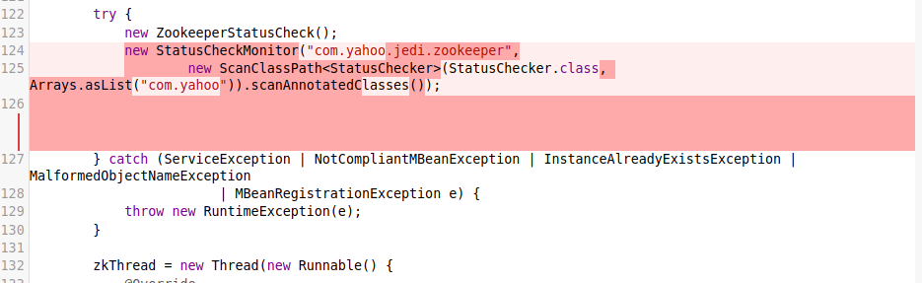
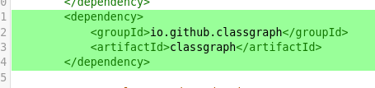
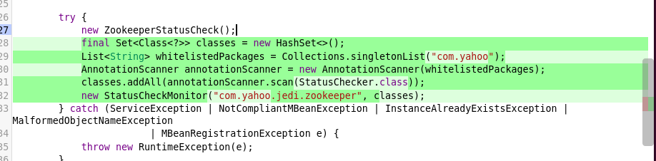
Classloader solutions - Scan with classgraph
Notes:
Replace ScanClassPath with ClassGraph(compatible with JDK8 and JDK11),

Slide 22
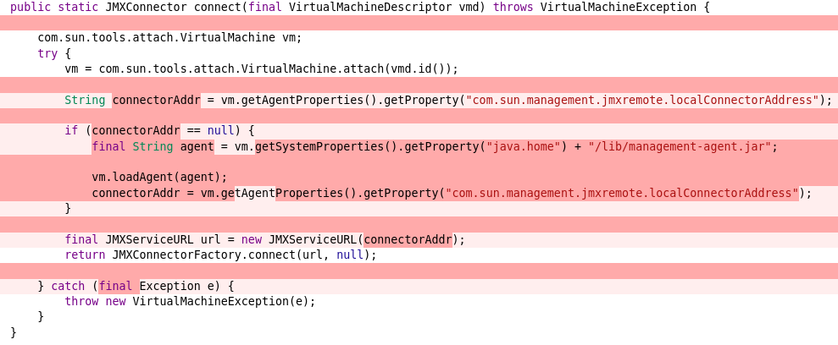
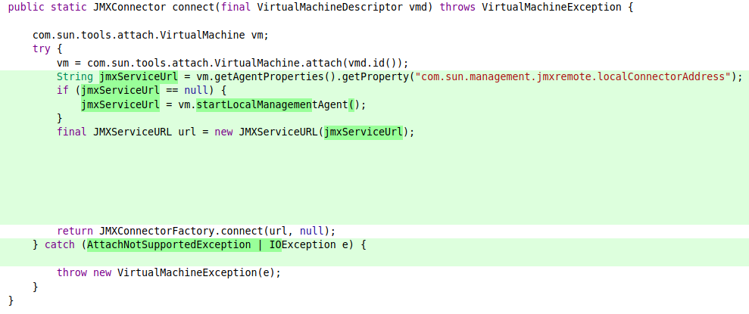
JMX
tools .jar is private, you should move to use the new jdk 9 apis.
Notes:
tools .jar is not available is private, these are new jdk 9 apis.

Slide 23
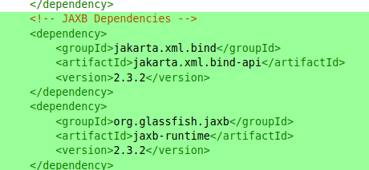
Maven changes
Java-ee was bundled in jdk8, but in jdk11 you need to declare the dependency explicitly for the libraries you need.
Notes:
https://gerrit.comms.corp.yahoo.com/#/q/owner:+sundarms+status:+merged+jdk11 - PR for JDK 11

Slide 24
Upgrade maven plugin to version 3.X
To support JDK 11 and above you need to use version 3.X of all maven plugins
Upgrade plugins as part of jdk upgrade for compilation avoid string instantiation PMD fix https://pmd.github.io/pmd-6.21.0/pmd_rules_java_performance.html#stringinstantiation
maven-release-plugin 3.0.0-M1
build-helper-maven-plugin 3.1.0
maven-resources-plugin 3.1.0
maven-assembly-plugin 3.2.0
maven-clean-plugin 3.1.0
maven-enforcer-plugin 3.0.0-M3
maven-pmd-plugin 3.13.0
maven-install-plugin 3.0.0-M1
maven-checkstyle-plugin 3.1.1
Notes:
https://gerrit.comms.corp.yahoo.com/#/q/owner:+sundarms+status:+merged+jdk11 - PR for JDK 11

Slide 25
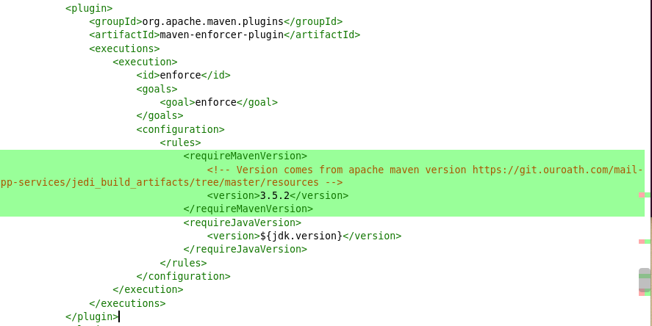
Minimum Maven version 3.5.2

Slide 26
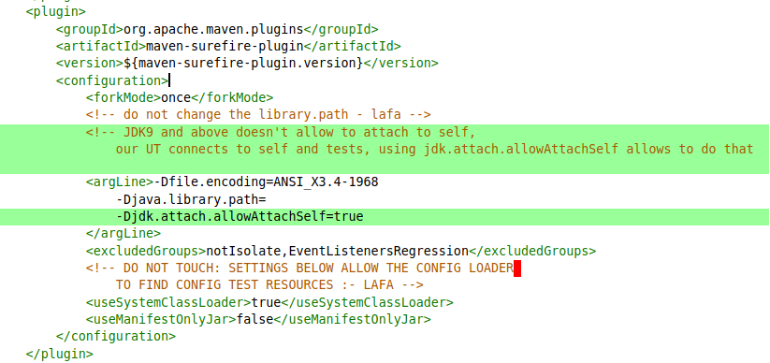
Maven surefire plugin
If your UTs use jmx connections, you need to change allowAttachSelf=true
Notes:
https://gerrit.comms.corp.yahoo.com/#/q/owner:+sundarms+status:+merged+jdk11 - PR for JDK 11

Slide 27
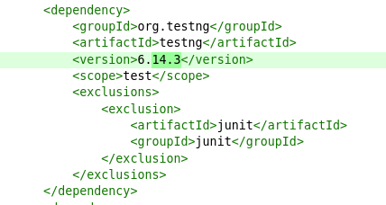
Maven testng version to work with JDK 11
Notes:
https://gerrit.comms.corp.yahoo.com/#/q/owner:+sundarms+status:+merged+jdk11 - PR for JDK 11

Slide 28
Upgrade yiv and yca to higher versions
add yinst pkg yjava_yiv 1.31.721
add yinst pkg yiv STABLE
# yca packages will be deprecated in 2021, if you need to use you need jdk 11
# mail team also reimplemented the yca client in pure java and we don't use the platform libraries anymore due to jni problems.
add yinst pkg yjava_yca 11.41.18
Notes:
https://gerrit.comms.corp.yahoo.com/#/q/owner:+sundarms+status:+merged+jdk11 - PR for JDK 11

Slide 29
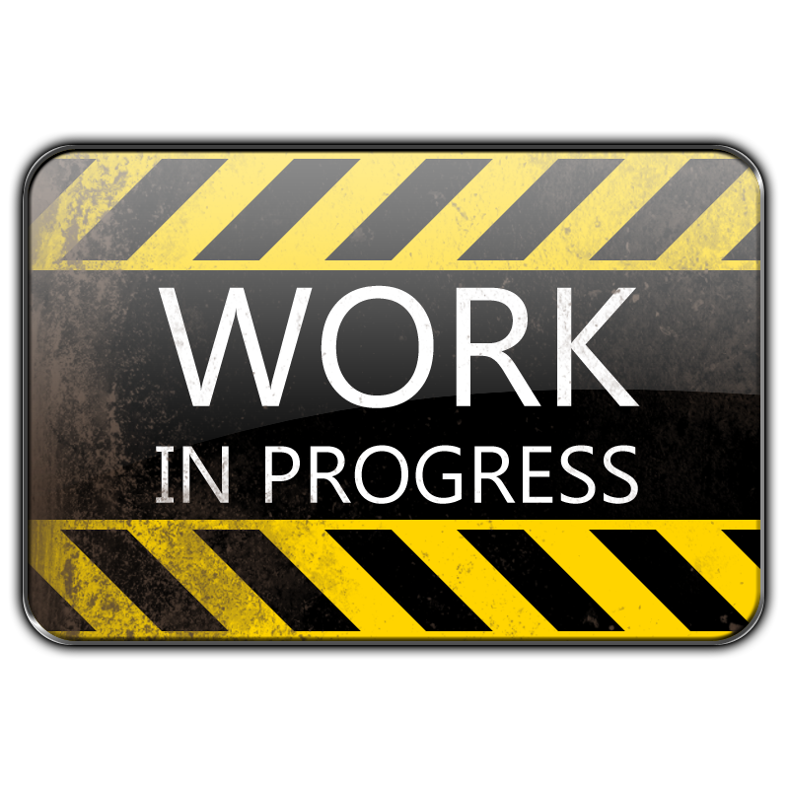

Ω “Safe Changes” for dual builds: NCP/Graviton
NCP/Graviton’s plan of attack
Start with graviton-examples (have both “gateway” and gRPC maven submodules)
Use maven “profiles” to build with JDK11 in separate component jobs and learn what diffs are needed
Migrate changes from profile to main and non-example jobs/repos (JDK8)
Deploy both Java 8 and Java 11 and run perf (yoyo) and functional (acceptance) tests.
Spin new versions of runtime and build base images with Java 11
Cutover and commit to Java 11 for runtime
Notes:
Now, briefly, some more callouts…

Slide 30
Concept and use-case for NCP/Graviton Java 11 upgrade
Concept: Safe Changes allows same Ω pipeline to have different component builds and tracks
Shares a common omega.yaml and scripts/app_configure, app_start, which can read $APP_VARIANT
Use-case: Have multiple deployments of same application for testing
NCP/Graviton build for Java 8 and Java 11, deploy to staging, and run yoyo on both
Will run various acceptance tests against the two deployments
Unused, but possible use-case: traffic splitting based on cookie or %
If you desire a more cautious rollout, you can route some percentage of traffic by cookie or %

Slide 31
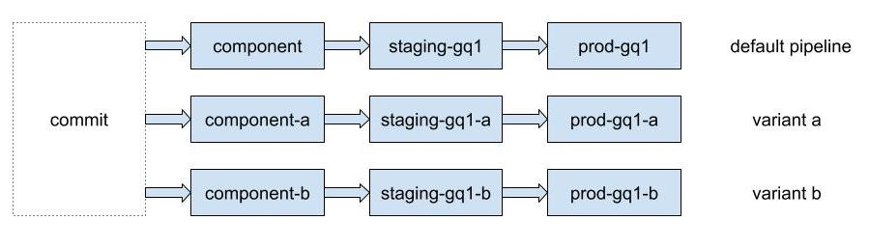
Variant parallel pipelines
Single branch and SD project with 'variant' jobs
From yo/omega-variants-deck
Notes:
Since this is such a common pattern, and we want to make OS upgrades easier in the future, Shashi and I updated the Omega pipeline automation to include these features in a more native way. The first new feature is call the 'variant' feature. The idea is, instead of being forced to branch the application code into multiple branches, applications can have a single branch and Screwdriver project, but have a variant pipeline within it. At the top, you see the original default pipeline. Then below that, any number of variant pipelines that be defined.

Slide 32
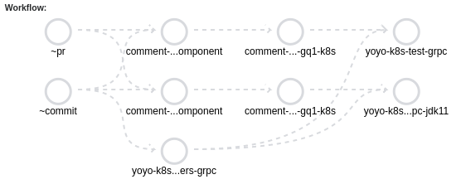
Simplified workflow (graviton-examples)
jdk11
jdk11
jdk11
yoyo attacker ⇒

Slide 33
Omega.yaml to support jdk11 variant
Original JDK8 omega.yaml
Original screwdriver.yaml
JDK11 omega.yaml
JDK11 screwdriver.yaml
variants:
- name: jdk11
comment-grpc-component:
environment: development
colo: gq1
cleanup: false
comment-grpc-jdk11-component:
environment: development
subdomain: jdk11
variant: jdk11
colo: gq1
cleanup: false
comment-grpc-component: &comment-grpc-component
requires: [ ~commit, ~pr ]
template: omega/k8s-generic@stable
image: docker.ouroath.com:4443/sieve/ylinux7-sieve-adoptjdk8-builder
comment-grpc-jdk11-component:
<<: *comment-grpc-component
image: docker.ouroath.com:4443/sieve/ylinux7-sieve-jdk11-builder

Slide 34
app_configure: differentiating on JDK11 variant
scripts/app_configure
# TODO(scr): Remove when base image exists and is set in variants
# Upgrade java
if [[ $APP_VARIANT == jdk11 ]]; then
yinst i yjava_jdk -tag yjava_jdk_adoptopenjdk11_latest -nostart -noautosave
ROOT="${ROOT:-/home/y}"
jvm_args_arr=(
-XX:+DisableExplicitGC
-XX:+UseG1GC
-XX:+ParallelRefProcEnabled
"-Xlog:gc:file=${ROOT}/logs/grpc/gc.log:time,level,tags:filecount=10,filesize=4M"
)
yinst set comment_grpc_service.jvm_args="${jvm_args_arr[*]}"
fi

Slide 35
Custom traffic routing with routing.yaml
If header matches a regex, divert request to a different environment. (if you use yo/evaluate experimentation platform, e.g.)
routing.yaml
prod-gq1:
additionalHttpRoutes:
- match:
- headers:
bucket:
regex: ".*bucket-jdk11.*"
route:
- destination:
host: "{{ $job := index .job "prod-gq1-jdk11" }}{{ $job.httpRoute }}"
port:
number: {{ $job.derivedServicePort }}
From yo/omega-variants-deck
Notes:
This example shows the Traffic distribution based on HTTP Headers between different deployments.
You can use Evaluate+ to set up test buckets with headers.

Slide 36
Custom traffic routing with routing.yaml
Divert requests to another environment by percentage
routing.yaml
prod-gq1:
overrideDefaultHttpRoute:
- route:
- destination:
host: "{{ $job := index .job "prod-gq1" }}{{ $job.httpRoute }}"
port:
number: {{ $job.derivedServicePort }}
weight: 95
- destination:
host: "{{ $job := index .job "prod-gq1-jdk11" }}{{ $job.httpRoute }}"
port:
number: {{ $job.derivedServicePort }}
weight: 5
From yo/omega-variants-deck
Notes:
This example shows Traffic distribution based on weight between deployments. Example shed 5% traffic to canary and 95% to production.

Slide 37
Ω “Safe Changes” for dual builds: NCP/Graviton
Challenges met so far:
Guice + Guice-multibindings upgrade 4.2.3 (not sure minimal version, but went to latest).
TestNG 7.0 - toString called BEFORE the test is run - some fields filled in by test (NPE - just check in toString)
Application names are already over the 63-char limit just for -prXXX (after 100 PRs, no PRs can deploy)
Garbage collection and logging settings to yjava_jetty - easy but had to figure them out
Notes:
For Application Names, working on reducing, but that’s somewhat unrelated to jdk11 unless your subdomain takes you “over the edge”.

